Slide 1
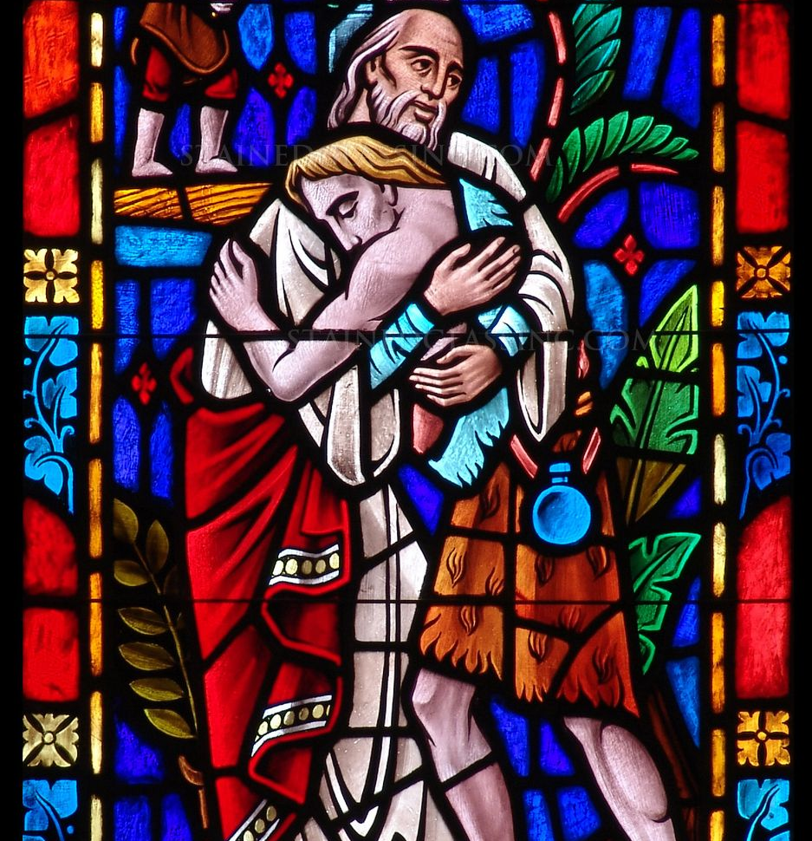
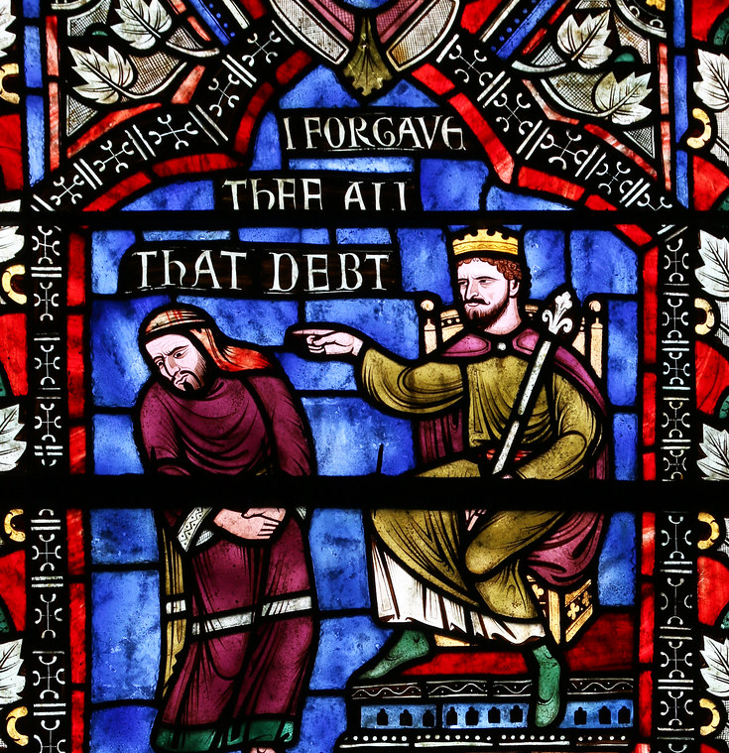
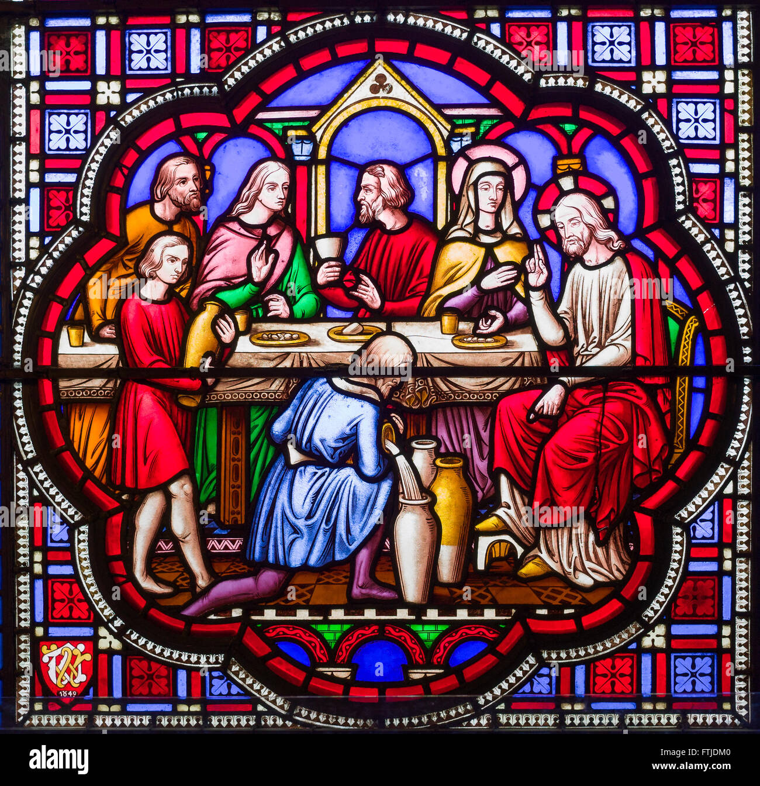
Parables: Class 3

Slide 2
Parables Series
June 8 – Parables About Who Belongs in the Kingdom
  Good Samaritan, The Wedding Feast, Laborers in the Vineyard
June 22 – Parables About Growing the Kingdom
  The Sower, Parable of the Talents, Light Under a Bushel
June 29 – Parables About Fulfilling the Kingdom
  Prodigal Son, The Two Debtors, Sheep and the Goats,
  Great Banquet

Slide 3
When will the “Kingdom of God” be fulfilled?
Jesus’ Parables and Eschatology
  Eschatology – understanding of the “end time”, comes from the Greek word eschaton, meaning the climax of the divine plan
  At least a dozen parables are explicitly eschatological; many more can be interpreted through that lens
Parable of the Mustard Seed
  Desire for God’s kingdom to come in full – but how will we know when it comes to pass?

Slide 4
When will the “Kingdom of God” be fulfilled?
Consistent Eschatology
  Jesus’ ministry exclusively looks ahead to a future coming of the Son of Man
Realized Eschatology
  Not about the future, but has been realized in the present
Inaugurated Eschatology
  “Already, but not yet” – Jesus’ ministry has begun this final age, but it is not yet realized in full

Slide 5
When will the “Kingdom of God” be fulfilled?
These eschatological views become a powerful interpretive framework for how we interact with the parables
My view – Acts 1:6-8
  So when they had come together, they asked him, “Lord, is this the time when you will restore the kingdom to Israel?” He replied, “It is not for you to know the times or periods that the Father has set by his own authority. But you will receive power when the Holy Spirit has come upon you, and you will be my witnesses in Jerusalem, in all Judea and Samaria, and to the ends of the earth.”

Slide 6
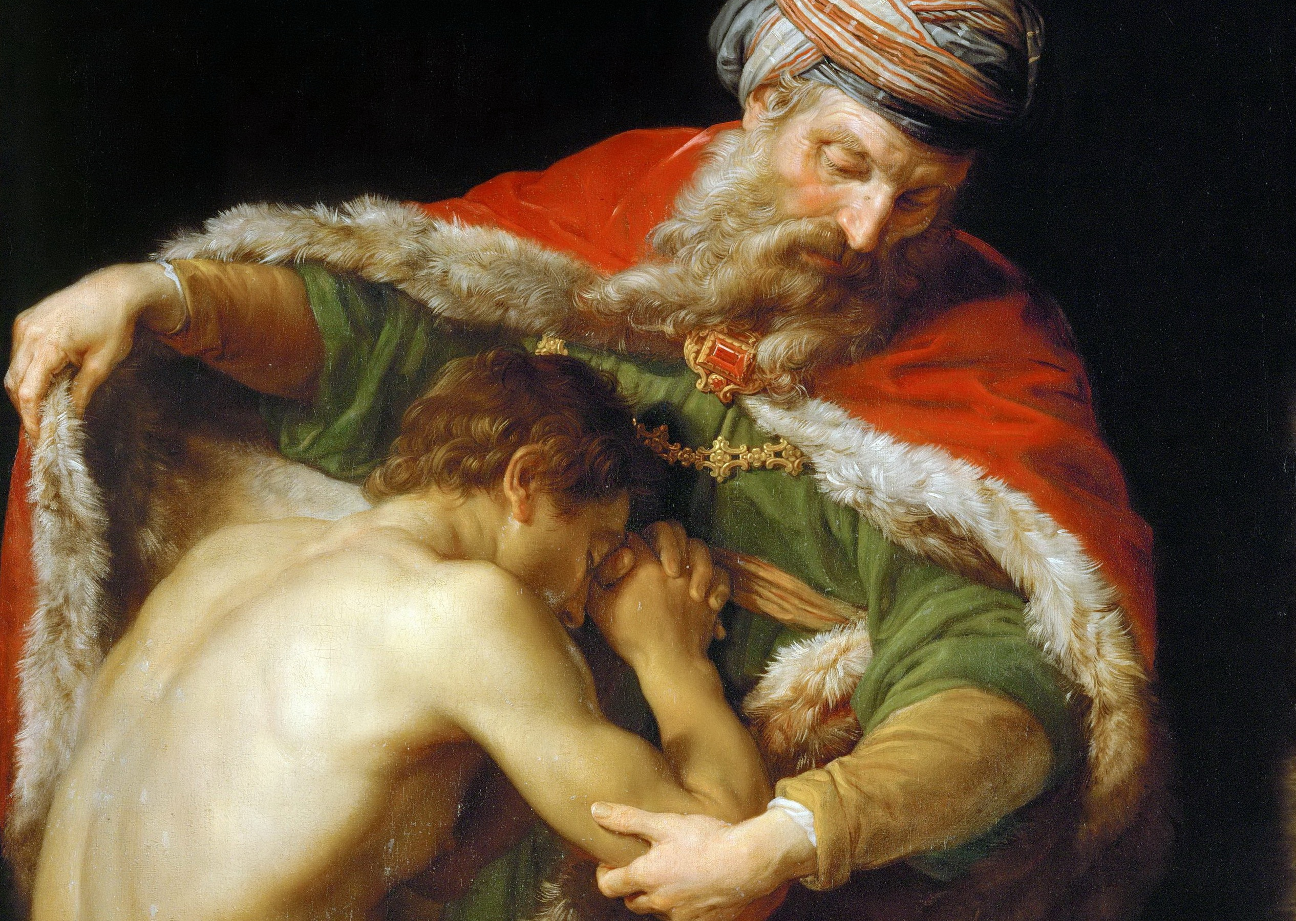
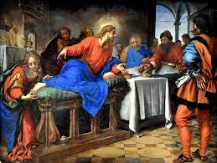
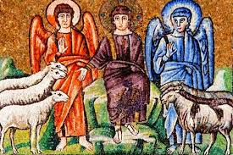
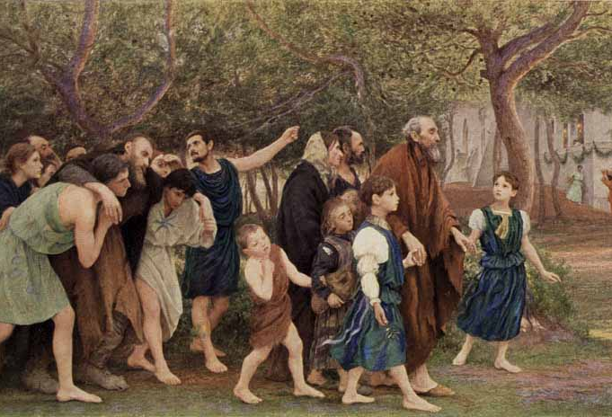
How will the Kingdom of God be Fulfilled?
Parable of the Prodigal Son
Parable of the Two Debtors
Parable of the Sheep & Goats
Parable of the Great Banquet

Slide 7
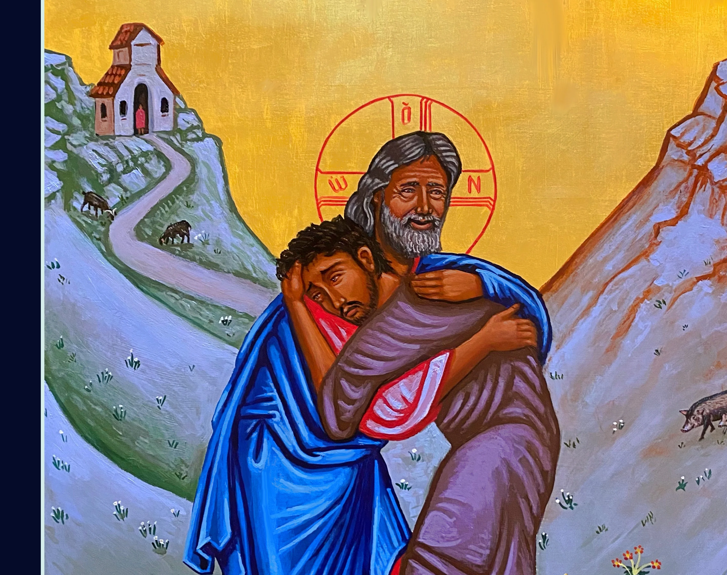
The Parable of the Prodigal Son
Luke 15:11-32

Slide 8
Parable of the Prodigal Son
Last and longest in a series of three parables around seeking the “lost” – Lost Sheep, Lost Coin, Prodigal Son
Prodigal – does not mean “rebellious”; is in reference to the younger son’s wasteful spending
Younger sons are typically favored in the biblical text… Jacob vs. Esau, Isaac vs. Ishmael, Joseph vs. brothers

Slide 9
Parable of the Prodigal Son
Numerous Themes present:
  Repentance
    Younger son intends to repent in v.18, but is pre-empted by Father
  Grace / Mercy
    Father is clearly meant to be understood as God seeking the lost
  Jealousy
    Older son has been associated with Christians, Pharisees, ourselves
  Wealth vs. the Father
  “This son was dead and is alive; he was lost and is found!”

Slide 10
Parable of the Prodigal Son
Eschatological Interpretation
  Luke 15:1 – Jesus tells these parables in response to Pharisaic grumbling against Jesus’ ministry to tax collectors and sinners
  Two previous parables use phrases “Joy in heaven” and “Joy in the presence of the angels” – is the celebratory feast meant to evoke the Great Banquet described in Luke 14?
  Consistent – Christ’s second coming will save the lost
  Realized – In Christ’s earthly ministry, he has saved the lost
  Inaugurated – Christ has come to save the lost; we are meant to help him in doing so until all are found

Slide 11
Parable of the Prodigal Son
Historically read during Lenten season – around our need for repentance, culminating in God’s abundant grace
Has also been interpreted through the lens of free-will and humanity’s inherent desire to sin
Subject of artistic works, books, and songs

Slide 12
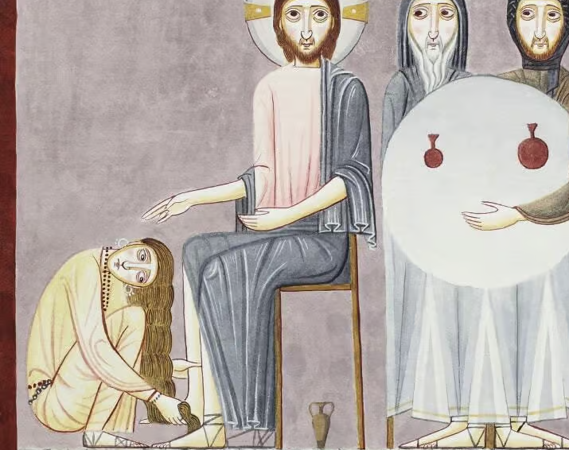
The Parable of the Two Debtors
Luke 7:36-50

Slide 13
Parable of the Two Debtors
Another instance of the Pharisees angry about who Jesus is at table with – a woman identified as a “sinner”
An alabaster jar would have been quite expensive – another indication of where we direct our wealth
Shared among all four Gospels (?) – with differences:
  John 12 - Mary of Bethany anoints Jesus’ feet with perfume
  Matthew 26 / Mark 14 – Simon the Leper (not Pharisee)

Slide 14
Parable of the Two Debtors
Numerous Themes present:
  Inability to pay our “debt” - sin
    Though not extravagant, the debt owed is significant
  Grace / Mercy
    As with Father from Prodigal Son, the creditor is merciful and gracious
  Forgiving Sin
    Solely an act of God; near explicit proclamation of Jesus’ divinity
  Gratitude and Acts of Faith
    “Your faith has saved you; go in peace”

Slide 15
Parable of the Two Debtors
Eschatological Interpretation
  God forgives our sins through faith
  The level of “debt” / sin does not matter to God; all may have the slate wiped clean
  Jesus is rejecting Simon the Pharisee’s legalistic belief that a sinner should not touch him – instead “the Son of Man has come to seek out and save the lost” (Luke 19)
  Consistent – Christ will forgive all sins
  Realized – Christ has forgiven all sins, “death has lost its sting”
  Inaugurated – Christ has forgiven all sins, if we come trusting in God’s mercy and forgiveness, we are forgiven too

Slide 16
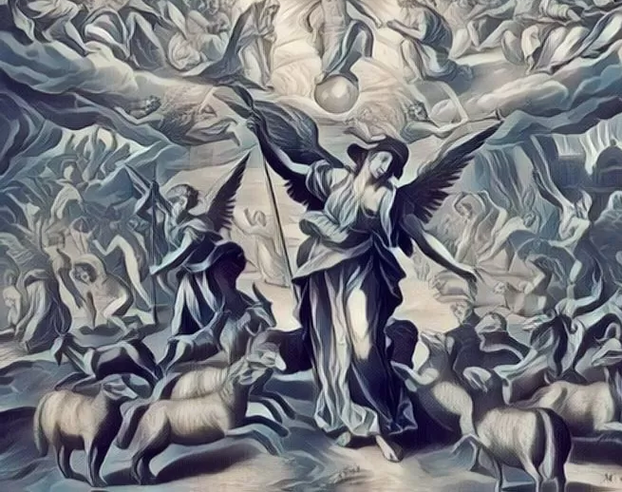
The Parable of the Sheep and the Goats
Matthew 25:31-46

Slide 17
Parable of the Sheep and the Goats
Likely a reference to Ezekiel 34 – which references God seeking out lost sheep, judging between sheep and sheep, rams and goats
Has been one of the central texts for the PC(USA) over the past several years, encouraging congregations to feed the hungry, clothe the naked, care for the sick, etc.
Places Jesus (“Son of Man”) on the throne instead of God; explicitly equating God and Jesus

Slide 18
Parable of the Sheep and the Goats
Numerous Themes present:
  Inability to pay our “debt” - sin
    Though not extravagant, the debt owed is significant
  Grace / Mercy
    As with Father from Prodigal Son, the creditor is merciful and gracious
  Forgiving Sin
    Solely an act of God; near explicit proclamation of Jesus’ divinity
  Gratitude and Acts of Faith
    “Your faith has saved you; go in peace”

Slide 19
Parable of the Sheep and the Goats
Eschatological Interpretation
  Our actions have immense consequences – and we are meant to care for the least and the lost in our world
  Explicitly names this sorting as a future event – “when the Son of Man comes in his glory”
  Consistent – This judgment will occur when Christ returns in the Second Coming
  Realized – Christ has already separated the “sheep” and “goats”
  Inaugurated – Through our actions, we can labor to build the Kingdom of God – confident that it will one day be known in full

Slide 20
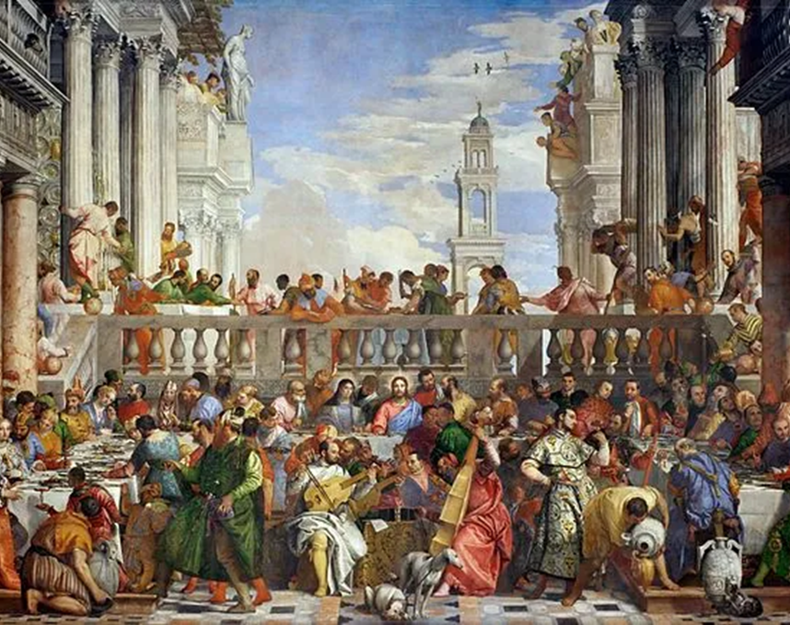
Parable of the Great Banquet
Luke 14:15-24

Slide 21
Parable of the Great Banquet
Yet another parable told around the table of a Pharisee!
Contains themes from all three of our previous parables:
  Prodigal Son – seeking out the lost
  Two debtors – invitation is freely given
  Sheep and goats – those who reject the invitation vs. those who are welcomed in
Vision of an expanded and broad Kingdom (see class 1)

Slide 22
Parable of the Great Banquet
Numerous Themes present:
  Our relationship to wealth / possessions
    Those who reject the invitation do so because of what they have
  God seeks out those on the margins
    “Bring in the poor, the crippled, the blind, and the lame”
  God seeks out those outside of Israel (aka Gentiles)
    “Go out into the roads and lanes” – the land outside the city
  Invitation is freely given, not earned
    Being seated at God’s table is a gift given to us

Slide 23
Parable of the Great Banquet
Eschatological Interpretation
  Proponents of each eschatological view can find support in verse 17: “At the time for the dinner he sent his slave to say to those who had been invited, “Come; for everything is ready now”
  Consistent – The dinner refers to Christ’s Second Coming, when all will finally be given the opportunity to eat at God’s table
  Realized – This passage refers to the Pharisees and others who have rejected their invitation to the Kingdom, welcoming instead Gentiles, the lost, etc.
  Inaugurated – Everything is ready; the Kingdom of God is at hand – we must accept our invitation and go out to invite others

Slide 24
How will the Kingdom of God be Fulfilled?
Parable of the Prodigal Son
Parable of the Two Debtors
Parable of the Sheep & Goats
Parable of the Great Banquet

Slide 25
How Will the Kingdom of God be Fulfilled?
Parable of the Prodigal Son
  God will seek out the lost, even those who have spurned faith
Parable of the Two Debtors
  God’s forgiveness is expansive, including those with great debt
Parable of the Sheep and the Goats
  God still cares deeply about our treatment of others
Parable of the Great Banquet
  God’s table is expansive, seeking out the lost, but we cannot forgo our invitation to live a faithful life

Slide 26
Parables Series
June 8 – Parables About Who Belongs in the Kingdom
  Good Samaritan, The Wedding Feast, Laborers in the Vineyard
June 22 – Parables About Growing the Kingdom
  The Sower, Parable of the Talents, Light Under a Bushel
June 29 – Parables About Fulfilling the Kingdom
  Prodigal Son, Two Debtors, Sheep and Goats, Great Banquet

